Slide 1
GYMKI
SEMESTER PROJECT
BY MUHAMAD HAMZA MOTIWALA

Slide 2
PROJECT TITLE
The name I decided on for my project is GYMKI
GYMKI is an abbreviation for Giki and Gym
In this presentation I will walk you through the whole process of how the program works
We will be discussing the scope of project, its features, tools, and technologies

Slide 3
MOTIVATION
My motivation is a need of my own.
I go to gym and use my phone notepad to write down what I did that day in the particular workout and that is a manual and a hectic process.
However, I thought of the app to be the one people like me want which is easily accessible and user-friendly.

Slide 4
PROBLEM DESCRIPTION
There are a lot people who find it hard to keep a record of their nutrition, calories, protein, and especially workouts. That is why my software comes in and solves the problem. Moreover,
There is a lack of computer-based Fitness trackers and a user-friendly system to give easy and free access to a user to make changes and access the exercises as well as calculators.
The purpose of GYMKI is to allow users to store details like the biodata and analyze where their body stands people mostly find it hectic to go to different sources and calculate their progress, therefore, GYMKI has it all in one place

Slide 5
SCOPE OF PROJECT
To make your workouts easily trackable
To calculate your macros like protein
To track your calories throughout the day
Minimizing the need to use multiple resources/apps.
A free fitness app or at least a reasonable one

Slide 6
FEATURES OF PROJECT
There are 5 main features GYMKI offers:
CALORIE CALCULATOR
CALORIE TRACKER
PROTEIN CALCULATOR
PROTEIN TRACKER
NEW WORKOUT SESSION

Slide 7
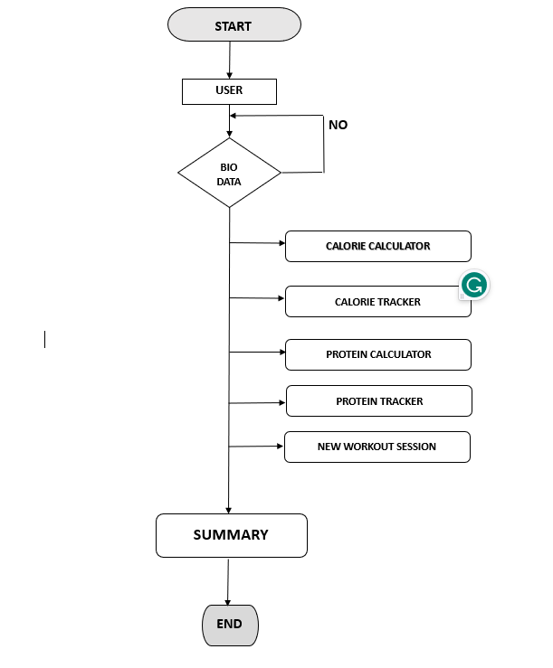
FLOWCHART

Slide 8
ALGORITHM
START
ENTER BIODATA/CREDENTIALS
DISPLAY MENU
USER PROMPT FOR DESIRED OPERATION
IF THE PROMPT IS WRONG CODE ENDS
IF THE PROMT IS CORRECT
SWITCH CASE STATEMENT WORKS AND PROCESSES THE OPERATION REQUIRED
ONCE THE DESIRED OPERATION IS DONE THE COMPILER ASKS THE USER FOR A CONTINUE PROMPT
IF USER SAYS 1, IT CONTINUES AND IF THE USER INPUTS 0 THE PROCESS ENDS,
WHEN INPUT IS 1, THE MENU POPS UP AGAIN AND THIS GOES ON UNTIL THE USER EXITS

Slide 9
TOOLS AND TECHNOLOGIES
Programming Language: C++
Operating System: WINDOWS
Compiler: VS CODE

Slide 10
TOPICS USED IN THE PROJECT
CONDITIONAL STRUCTURES
IF/ELSE
SWITCH
LOOPS
1D ARRAYS
FUNCTIONS AND RECURSION
POINTERS AND REFRENCES

Slide 11
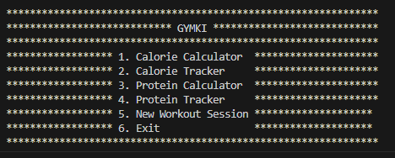
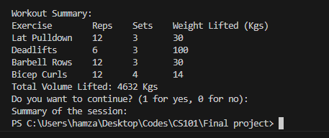
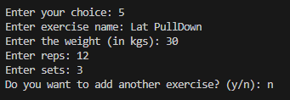
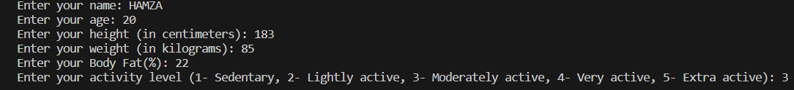
EXISTING SOLUTIONS

Slide 12
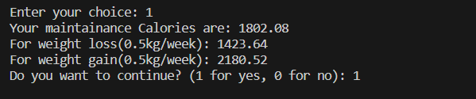

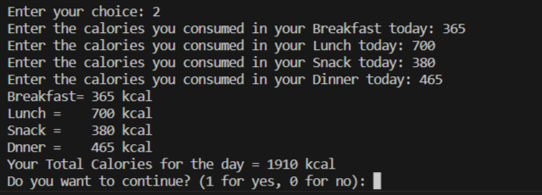
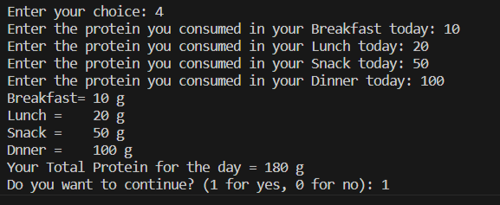
EXISTING SOLUTIONS

Slide 13
THANKYOU!!

